Slide 1
2D Drawing and Animation Techniques
Guilford County SciVis
V106.04

Slide 2


Early Animation Processes
Animation is created when still images are played in rapid succession so that they appear to produce images that are constantly moving.
Animation appears to have continuous motion because the human eye (brain) “holds-onto” the still image for just a brief moment after it is viewed, and the image is still “there” (in your brain) when the next image is viewed.
The timing between individual images must be fast enough for the sequence to appear smooth.

Slide 3
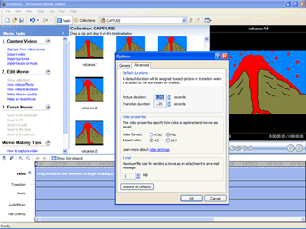
Early Animation Processes
The National Television Standards Committee (NTSC) frame rate = 30 frames per second for television (North America and Japan).
PAL (Phase Alternate Line) is the European standard of 25 frames per second.
The standard rate for film (motion pictures) = 24 frames per second.
A frame rate of 30 fps will require 1800 images for one minute of animation (30 fps x 60s).

Slide 4
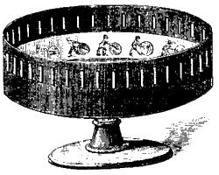
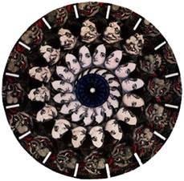
Early Animation Processes
The Zoetrope was a device that was used to produce animation in the 1800s. It consisted of a circular frame holding individual, sequenced images, and a fixed viewpoint through which the spinning pictures were viewed. The term “movies” comes from the moving images.

Slide 5
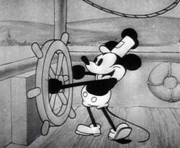
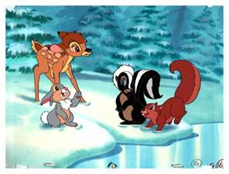
Early Animation Processes
The Walt Disney Studios developed animation into a modern art during the 1930s and 1940s.
The different “layers” of the animated scene were painted onto transparent sheets, called cels.
A hierarchy of artists was developed for drawing and painting the sequences of images.

Slide 6

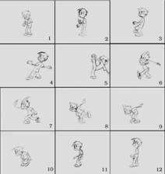
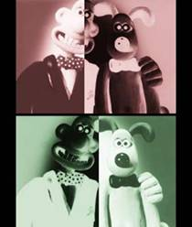
Early Animation Processes
A master artist would draw the most important or key frames (“keyframes”), and less-skilled or less-experienced artists would fill in the action for the in-between (“tweens”) frames. Other artists would paint or fill the outlines with color.
Stop-action animation uses clay or other models whose positions are sequentially altered and photographed for each frame.

Slide 7
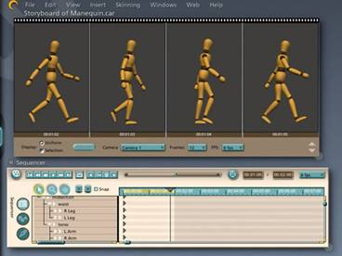
Computer Animation
Unlike early animation, where every frame must be created to produce movement, in computer animation you define points in time (known as keyframes) and the computer draws all of the in-between frames.

Slide 8
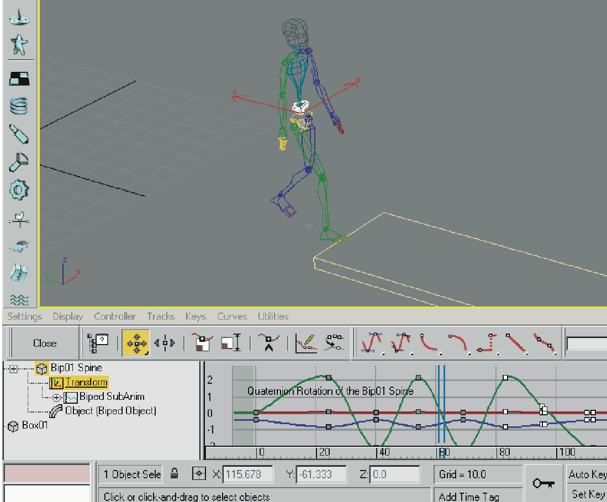
Computer Animation
Position the object to be animated where you want the action to begin; this is first keyframe.
Set the number of frames that you want to use for the animation sequence. A one second “movie’ would typically use 30 frames per second (30 fps NTSC); two seconds would use 60 frames, etc.
Move, scale, or deform the object to become the next keyframe.

Slide 9
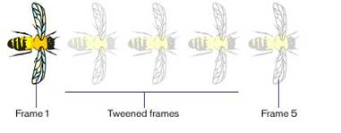
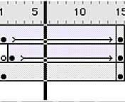
Computer Animation
Instruct the computer to calculate all of the transformations that will occur between the first keyframe and the last.
The computer will produce the 28 additional “in-between” images (tweens) needed for the one second of animation (you created the other two frames, the keyframes, for a total of 30).

Slide 10
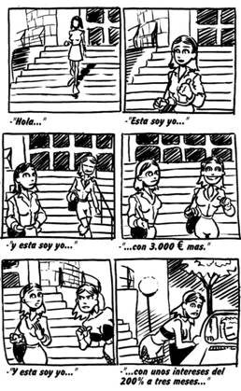
Storyboarding
A storyboard is a graphic, sequential depiction of an animation that is going to be created. It is a visual script designed to make it easier to see the animation scenes before they are created.
A storyboard identifies the major events in the story and illustrates them in cells (small squares or rectangles), which are drawn out in a sequential pattern.
Example Storyboard

Slide 11
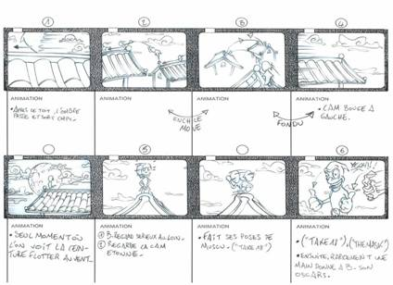
Storyboarding
Storyboards are used for movies, TV, commercials, and animation.
The artwork does not have to be pretty or complex, but it should be neat and comprehensible.
The pictures in the storyboard should be accompanied by text.

Slide 12
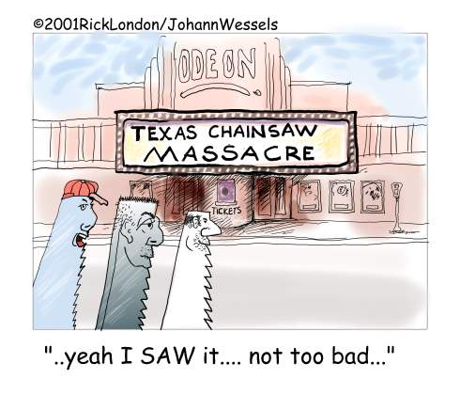
The End

